Slide 1
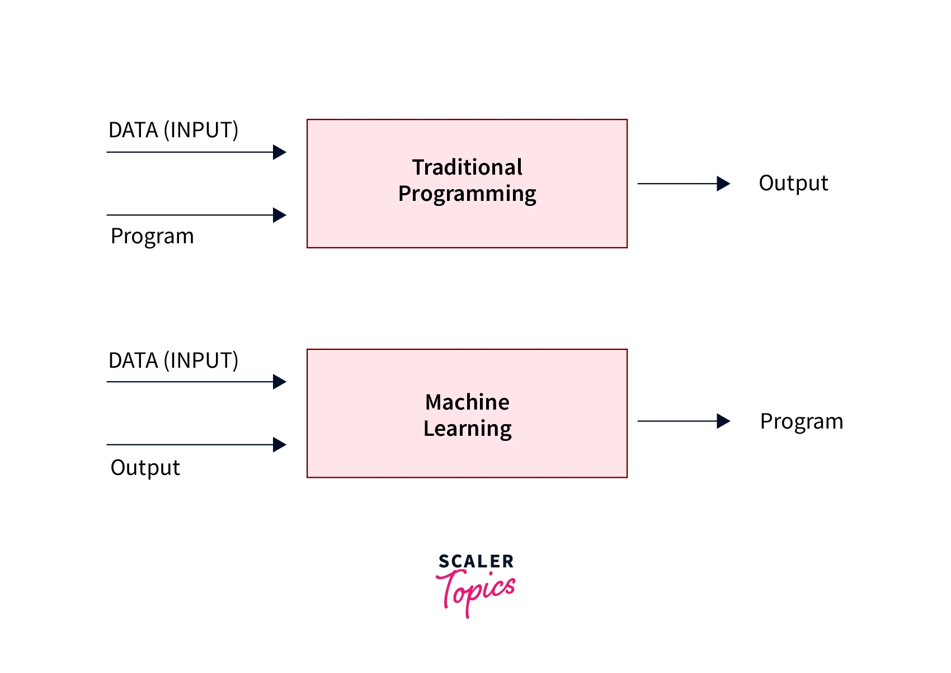
Introduction to Machine Learning
Moving from "Follow Instructions" to "Learn Patterns“
Instructor: Zaryab Ahmad Khan

Slide 2
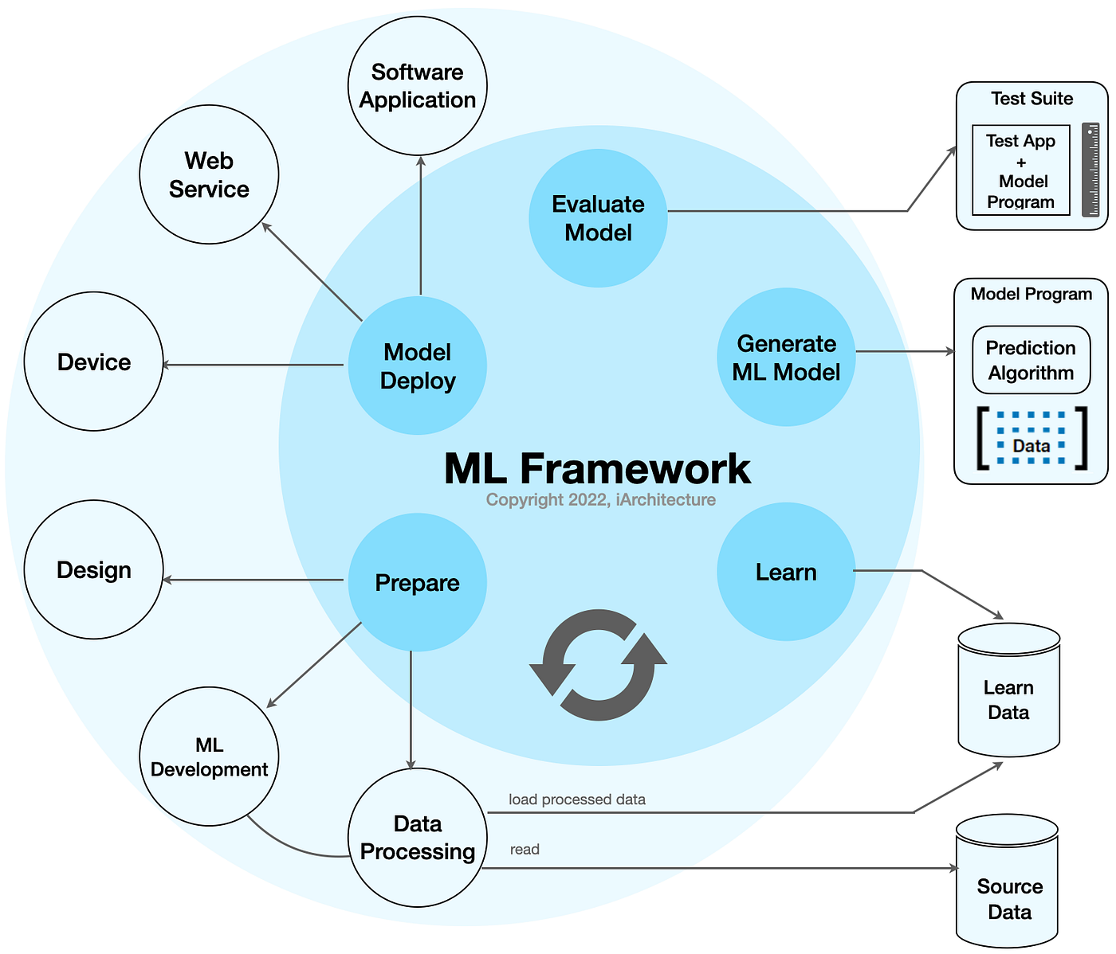
The ML Landscape
Traditional Programming: You write the rules (If/Else). The computer follows them.
Machine Learning: You show the computer examples (Data + Answers). The computer writes the rules.
Analogy: Teaching a child to recognize a cat by describing it (Traditional) vs. showing them 1,000 photos of cats (ML).

Slide 3
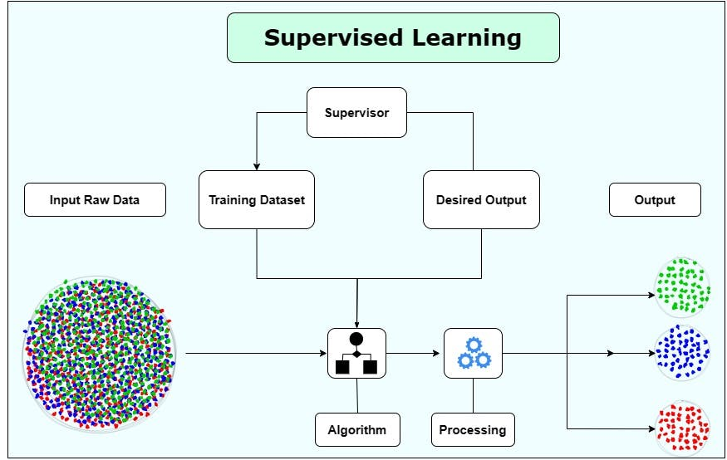
Supervised Learning (The Guided Path)
Concept: Learning with a "Teacher".
Data Type: Labeled (Input + Target Answer).
Real-World Use:
Predicting house prices based on square footage.
Identifying if a medical scan shows a tumor or not.

Slide 4
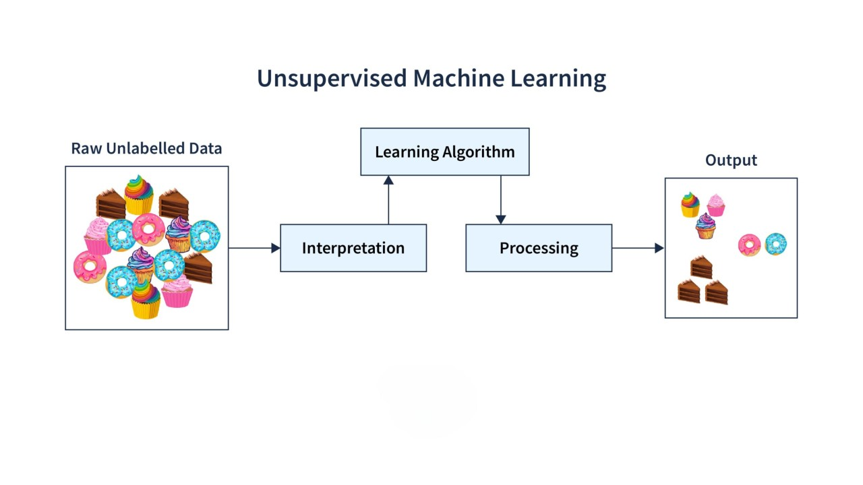
Unsupervised Learning (The Explorer)
Concept: Finding "Hidden Structure" without help.
Data Type: Unlabeled (Input only).
Real-World Use:
Customer Segmentation: Grouping shoppers by spending habits.
Anomaly Detection: Finding unusual bank transactions.

Slide 5
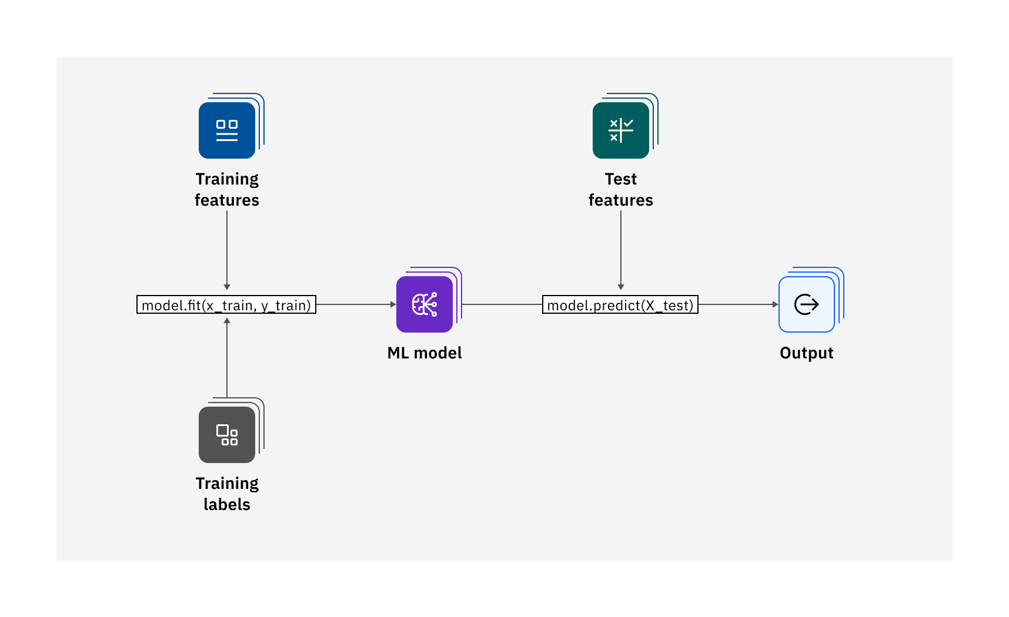
Why Scikit-Learn?
Standardization: Use the same "Fit/Predict" workflow for almost any model.
Efficiency: Built on NumPy and SciPy for high performance.
Community: The most documented ML library in the world.

